Slide 1

LECTURE 1 – ICT2153
INTRODUCTION TO INTERNET PROGRAMMING
Department of ICT
Faculty of Technology

Slide 2

Objectives
Identify the basics of client server architecture
Identify the different components for developing client/server applications

Slide 3
Internet
A global system of interconnected computer networks that use the standard Internet protocol suite (TCP/IP) to serve billions of users worldwide
When two computers are connected over the Internet, they can send and receive all kinds of information such as text, graphics, voice, video, and computer programs
In the late 1960s, ARPA (the Advanced Research Projects Agency) ARPA proceeded to implement the ARPANET, which eventually evolved into today’s Internet
https://www.youtube.com/watch?v=Dxcc6ycZ73M
Notes:
According to Webopedia, the Internet is a worldwide system of connected networks. Each network consists of millions of computers, servers, routers, and printers. You can think of the Internet like the telephone network or the interstate highway system. You may have even heard people refer to the Internet as the Information Super Highway. The networks that make up the Internet may be owned and maintained by different companies but messages and data move across all of them without regard to ownership because they all use the same protocol or language to communicate.

Slide 4
Web Application
A computer program allowing website visitors to view or submit and retrieve data to/from a database over the Internet using their preferred web browser
Web application use a combination of,
server side scripts (PHP / ASP) to handle the storage and retrieval of the information and
client side scripts (JavaScript / HTML) to present information to
users

Slide 5
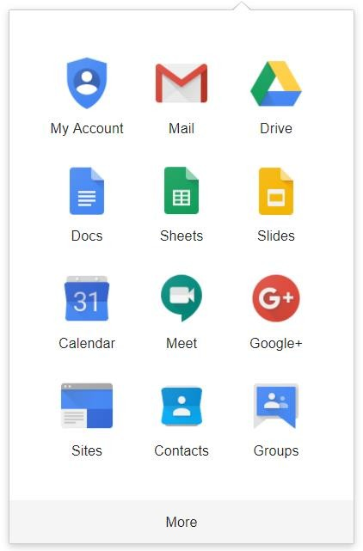
Web Application Example
Google Apps

Slide 6
Web Client and Web Server
Web client
Browser that makes the requests to the server
Web Server
Responds to client requests by providing resources
Web server and client communicate with platform independent Hypertext Transfer Protocol (HTTP)

Slide 7

Web Server
A Web server consists of a physical server, server operating system (OS) and software used to facilitate HTTP communication
Web server software runs on web server machine
Responds to client requests by providing resources
Executes server side scripts (PHP,JSPs, ASP, etc) that provide functions such as database accessing

Slide 8
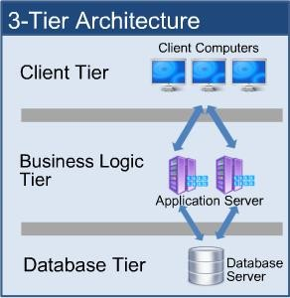
3- Tier Architecture

Slide 9
Scripting
Scripting is just a way to automate getting information to and from your computer (and other computers)
A script or a scripting language is a computer language with a series of commands within a file that is capable of being executed without being compiled
Server side scripting languages
Perl, PHP, Python
Client side scripting languages
JavaScript

Slide 10
Client Side Scripting
The client is the system on which the Web browser is running
Enhances functionality and appearance
Makes pages more dynamic and interactive
Client-side scripts are interpreted by the browser
Client side scripting rely on the user’s computer. If the computer
is slow they may run slowly
Ex: JavaScript

Slide 11
Server Side Scripting
The script is interpreted by the server, run on the server and generate results which are sent to the user
Designed to interact with back-end permanent storage, like databases, and process information from the server to access the database
Facilitates the transfer of data from server to browser, bringing pages to life in the browser
Ex: processing and then delivering a field that a user requests or submits in a form
Server-side scripts are never seen by the user
Examples:
ASP, JSP, PHP

Slide 12
Client Side Scripting vs. Server Side Scripting
Client-side scripts
Downloaded, interpreted and executed by the browser
Enhance web pages with allowing access to functions of the web browser of the user’s computer
Validate user input
Reduce requests needed to be passed to server

Slide 13
Client Side Scripting vs. Server Side Scripting
Server side scripting
Execute on server
Generate custom response for clients
Wide range of programmatic capabilities
Access to server-side software that extends server functionality

Slide 14
LAMP - Linux
Computer operating system assembled under the model of free and
open source software development and distribution
Runs each of the other components
Some popular Linux distributions are,
Ubuntu Linux
Linux Mint
Arch Linux
Deepin
Fedora
Debian

Slide 15
LAMP – Apache Web Server
Provides the mechanics for getting a Web page to a user
The PHP component actually sits inside Apache, and you use
Apache and PHP together to create your dynamic pages
Free and Open-source
Currently the most popular Web server application

Slide 16
LAMP – MySQL
Free and open source
Provides the data-storage side of the LAMP system
Support different operating systems
Within the Web application, all the data, products, accounts,
and other types of information will reside in this database

Slide 17
LAMP – PHP
PHP: Hypertext Preprocessor
A widely-used general-purpose scripting language that is especially suited for web development and can be embedded into HTML
Popular server-side scripting technology
Open-source
Anyone may view, modify and redistribute source code
Supported freely by community
Platform independent

Slide 18

Questions

